Slide 1



Mobile Phone Distribution Management Software
represented by
521H0462 - Nguyễn Thạch Trường Lạc
521H0458 - Trần Trọng Khoa

Slide 2
A Mobile Phone Distributor needs a software to manage the flow of products to authorized reseller / agents with the following functions
Accountants shall be able to create Good Received when the distributor import goods.
Reseller / Agents shall be able to place an order of items and choose a payment method, also see the status of their orders.
Accountants shall be able to create Goods Delivery Note to deliver goods to agents, and update the status of orders.
Accountants shall be able to view incoming/outgoing stock report, best-selling products and revenue report monthly.
Project summary

Slide 3

Deployed functions

Slide 4

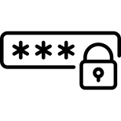
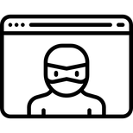

Sign in function
Submit account
Verification
Annoucement
username and password are created by organization
create a query to database and check if the submitted account is existed
annouce to user whether the account is verified or not

Slide 5



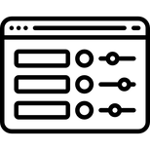
Create Good Received
Create new products
Import products
Inventory control
Create product if it isn't existed in the warehouse
Import products into warehouse
Review stock inventory

Slide 6
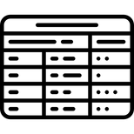


Create Good Delivery Note
Authorized units
List of orders
Export orders
Display all the authorized agents and reseller
Show all detail informations about order of all units
Confirm status of order as well as print out the bill.

Slide 7



Cyclical Statistics
Incoming
Outgoing
Best Selling
Display all the import orders
Display all the export orders
Display the top selling product

Slide 8


Cyclical Statistics
cont.
Revenue monthly
Chart
Display profit by month
Display the chart of profit earn by month

Slide 9

The insights I have gained from completing my final project
Knowledge | Design and development of applications | Technical skills | Database management | Project management
Process | Throughout the project, I acquired skills in designing and developing applications that facilitate the management of business processes. The processes may range from order and inventory management, sales tracking, and report generation. | When developing the application, I learned how to use programming languages, software development tools, and frameworks to build functional, efficient, and user-friendly applications. | I learned how to create and manage databases and work with SQL for storing, querying and managing data effectively. | Developing an application requires project management skills. I learned how to schedule project phases, create work plans, allocate resources, and work collaboratively with other team members.

Slide 10
Thanks for listening

